Slide 1
ChapterCache
Say hello to budget-friendly wisdom
Notes:
- How many of you have unused textbooks that you want to get rid of?
-Now how many of you are looking for a cheaper alternative to find your textbooks?
- Many students have unused textbooks but lack a reliable connection to sell or buy them.
- This is why we made ChapterCache
- ChapterCache is a Calvin specific app meant to help you connect with other students looking to buy a
nd sell used textbooks
- Say goodbye to wallet-wincing prices; welcome a marketplace with budget-friendly wisdom!

Slide 2
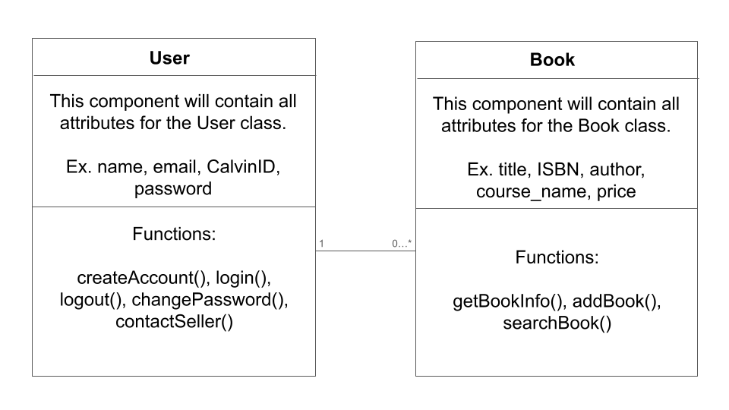
Domain Model

Slide 3
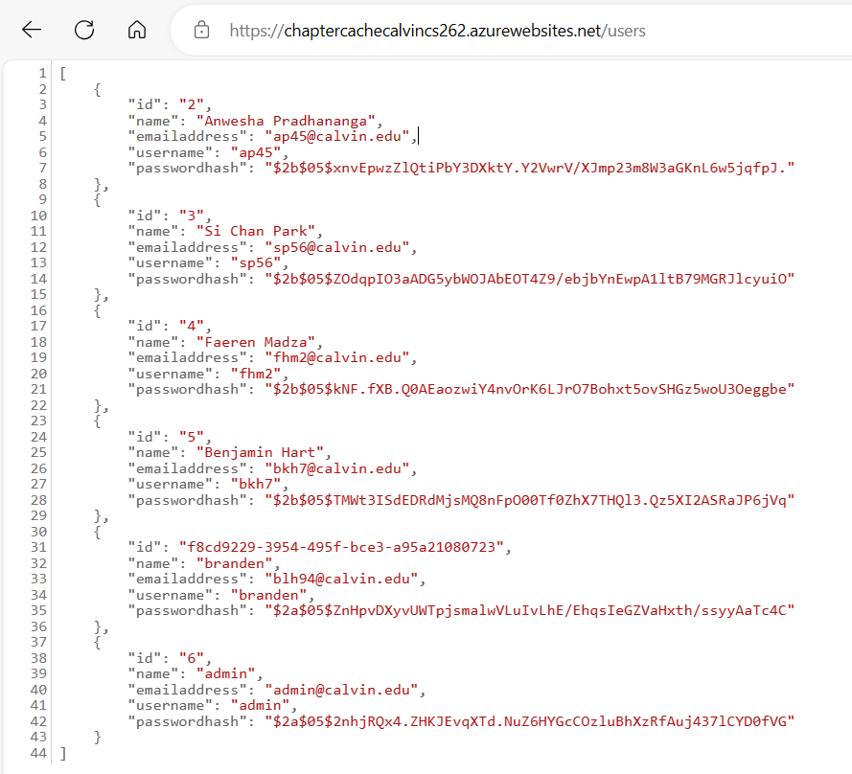
Database - Users

Slide 4
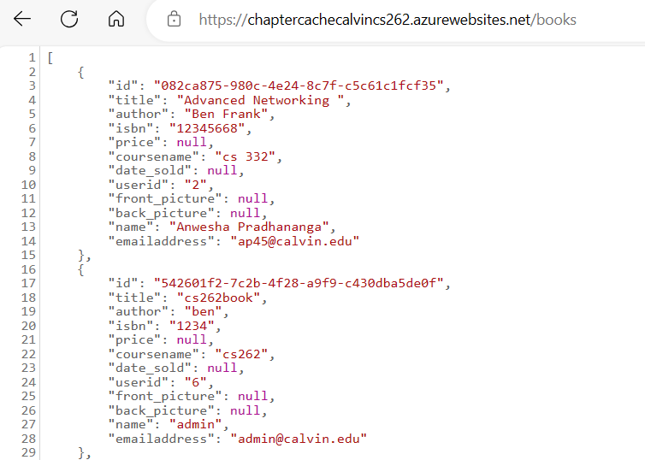
Database - Books

Slide 5
Demonstration

Slide 7
Next Steps

Slide 8
Thank you
Questions?

